Slide 1


INTERNSHIP ON IMAGE PROCESSING AND ANTENNA DESIGN
SJC INTITUTION OF TECHONOLGY
Internship Guide
Shreehari H S
Assistant Professor
Dept of ECE, SJCIT
Internship Coordinator
Santhosh G
Assistant Professor
Dept. of ECE, SJCIT
Presented By
Annavajjala Niketh Sandilya
USN:1SJ20EC010
Dept. of ECE,SJCIT

Slide 2
OUTLINE
Company Profile
About Internship Field
About Internship Topic/S
Task Performed with Results
Advantages, Disadvantages
Applications
Reflection
Conclusion
References

Slide 3

DHRITVAN SPACE LAB
It is a ground station with the sole purpose of collecting real-time satellite image data and decoding it to produce a picture. This space lab primarily aids with technology comprehension and hands-on experience.

Slide 4
CONTENTS
Part A: Image Processing
1.What is Image Processing
2.Introduction to Software and some basic concepts.
3.Using of Single threshold value to create a mask.
4.Using of two threshold value to create a mask and its significance
5.Counting of Number of Balloons
Part B :Antenna Design
1.Basics of a Antenna and its dependency on its parameters.
2.Introduction to Software and a sample design.
3.Creating a microstrip path antenna for frequency of 33.5MHz.
4.Creating a MIMO antenna for frequency of 34MHz.
5.Creating a Circularly polarized antenna for frequency of 34.5MHz.

Slide 5
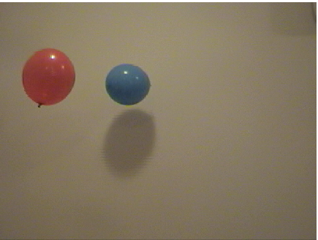
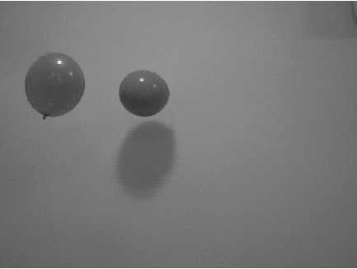
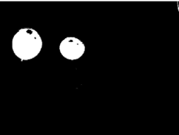
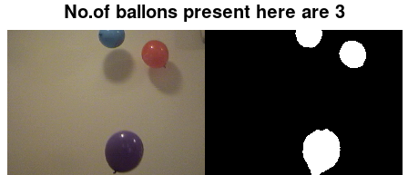
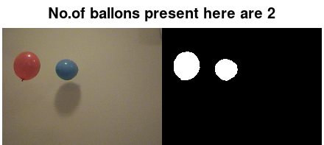
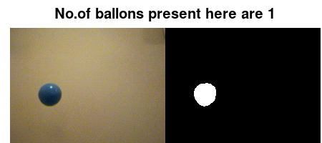
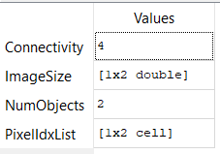
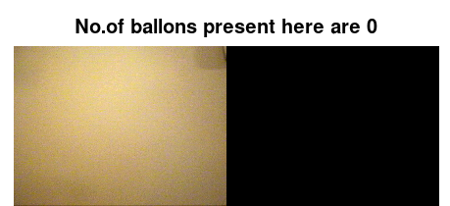
INTRODUCTION TO IMAGE PROCESSING
Pre-Processing
Segmentation
Feature
Extraction
Classification

Slide 6
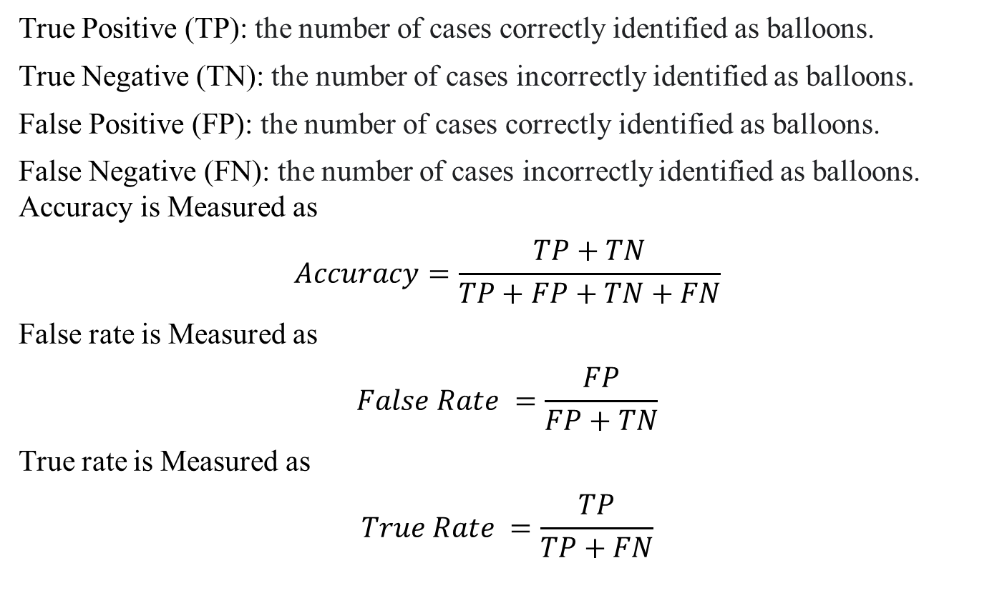
Process of calculating Accuracy by comparing with Ground truth
True Positive (TP): the number of cases correctly identified as balloons.
True Negative (TN): the number of cases incorrectly identified as balloons.
False Positive (FP): the number of cases correctly identified as balloons.
False Negative (FN): the number of cases incorrectly identified as balloons.
Accuracy is Measured as
$$Accuracy=\frac{TP+TN}{TP+FP+TN+FN}$$
False rate is Measured as
$$False Rate =\frac{FP}{FP+TN}$$
True rate is Measured as
$$True Rate =\frac{TP}{TP+FN}$$

Slide 7
TASK -1
With the use of a single threshold value that ranges from 0 to 255, make a mask for the image and assess its accuracy by comparing it to the ground truth. Find the image with the highest level of accuracy and its threshold.

Slide 8
SOLUTION FOR TASK 1
1. Take into account the range of 1 to 254 since we already
2. By establishing a threshold value and contrasting it with the real data, or ground truth, accuracy can be attained.
3. The image's maximum level of precision will help determine its THRESHOLD value.

Slide 9
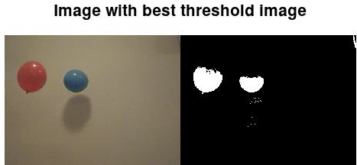
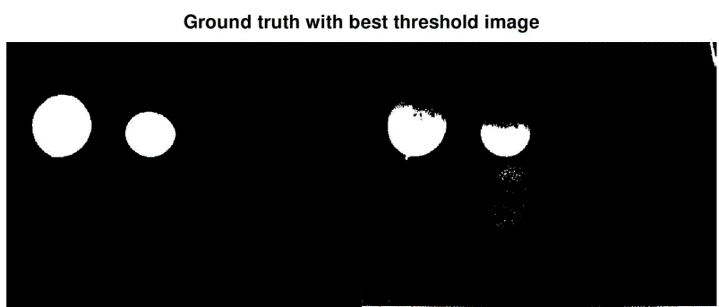
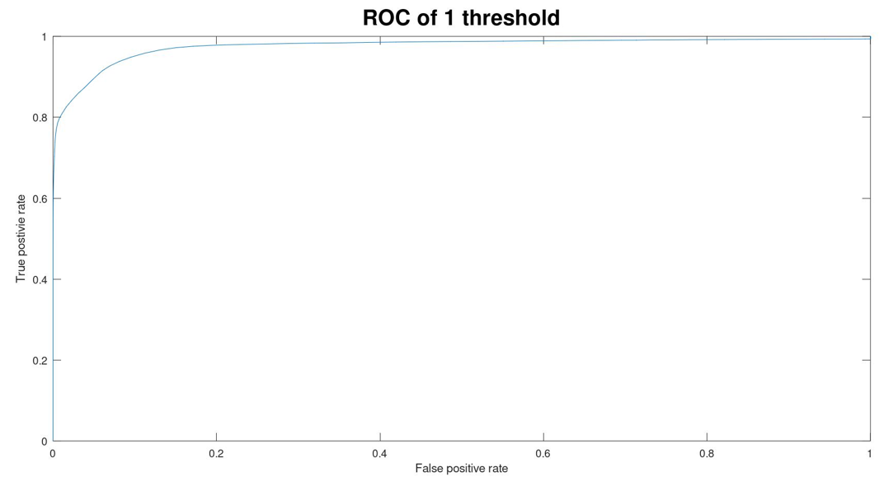

Slide 10
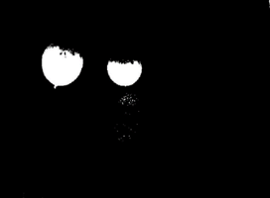
TASK 2
As utilizing a single threshold value results in inaccurate mask, we must utilize multiple threshold values, as an example, taking into account two thresholds by employing two planes, the RED and GREEN.

Slide 11
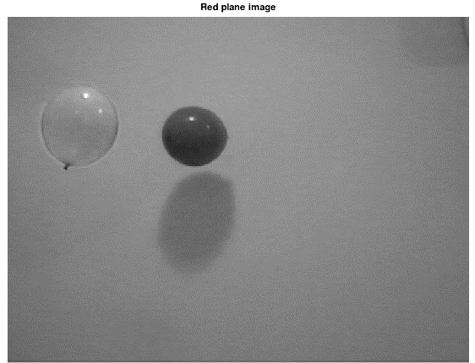
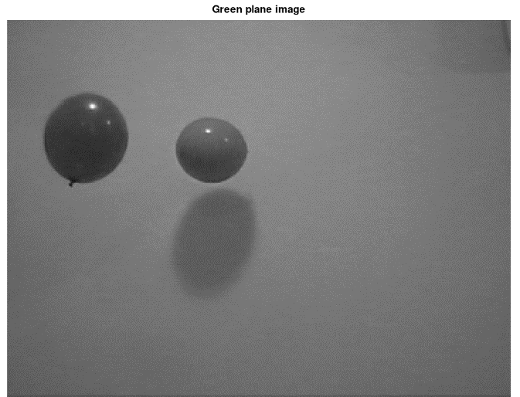
SOLUTION 2 FOR TASK 2
The index of the image in both the red and green planes can be found using the accuracy approach while using the same threshold parameters. Comparing the Ground truth image reveals even this precision.

Slide 12
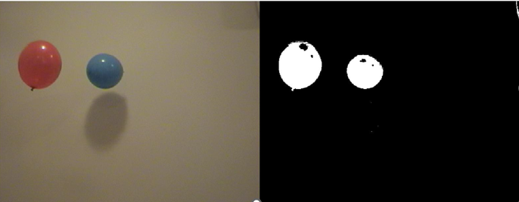
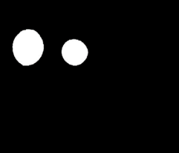
We can acquire the best mask that can be made by employing two planes by using the same way of constructing a mask by a single threshold that is applied for both planes.

Slide 13
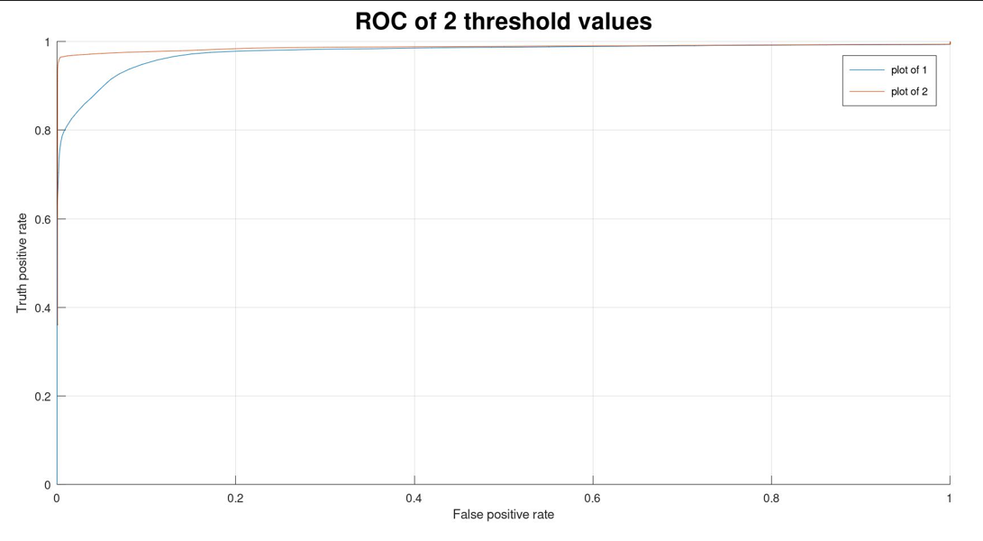
COMPARAING SINGLE AND DOUBLE THRESHOLD
 | SINGLE THRESHOLD | DOUBLE THRESHOLD
Accuracy | 0.9851 | 0.9964
Index of Image | 91 | 93, 85
Compared to a single threshold mask, the mask has More
Accuracy.

Slide 14

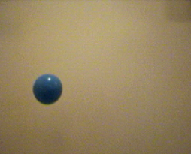
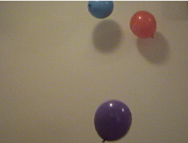
TASK 3
TASK 3
Count the number of balloons present in all the images in the data set of 51 images.
0 balloons
1 balloon
2 balloons
3 balloons

Slide 15
SOLUTION OF TASK 3
1.The Object must now be classified by converting RGB into an HSV plane and attempting to determine which of three planes has the most categorization of the Object in the image.
2. Using morphological techniques to bring the image as near to the ground truth as possible.
3.Ccalculate the number of Area of interests.

Slide 16
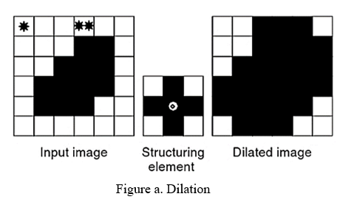
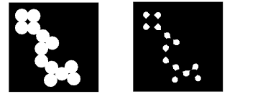
MORPHOLOGICAL OPERATIONS
Imdilate:
Imerode
Imopen:
Dilation followed by Erosion
Imclose:
Erosion followed by Dilation

Slide 17
RESULTS

Slide 19
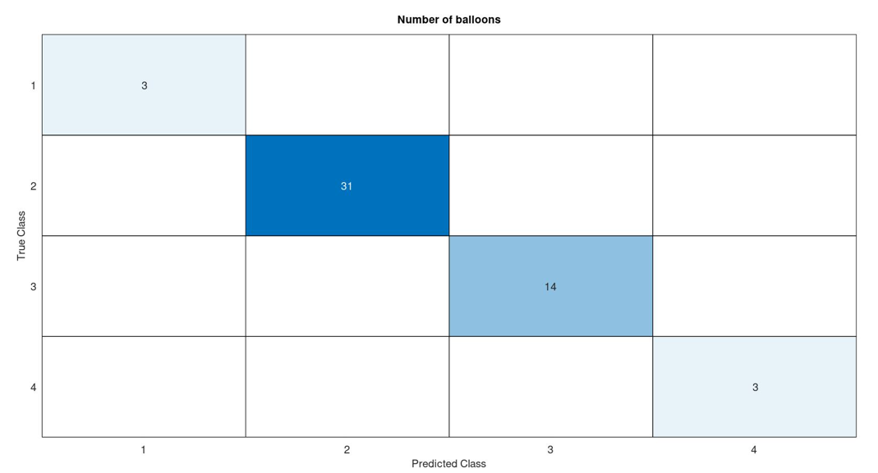
Confusion Matrix

Slide 20
Some Real time application LEAF segmentation

Slide 22
ANTENNA DESIGN

Slide 23
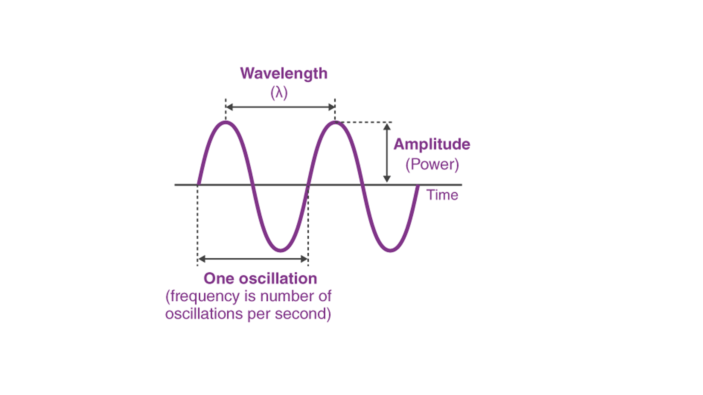
Antenna Design depends on various parameters
1.Frequency
2.Wavelength
3.Impedance matching
4.VSWR and Reflected Power
5.Bandwidth
6.Presentage Bandwidth
7.Radiation Intensity

Slide 24
Task-4
Creating a design of Microstrip Rectangular Patch Antenna in HFSS for operating frequency(f) of 33.5MHz , display all the resulting parameters.

Slide 25
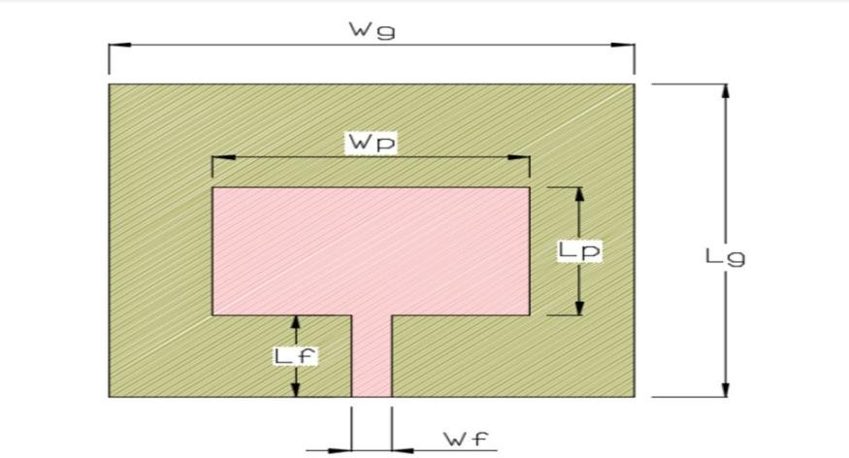
Design Parameters | Description | Obtained values from Calculation(mm) | Optimized values for Performance(mm)
Wp | Width of patch | 3.386 | 3.62
Lp | Length of patch | 2.551 | 2.45
Wg | Width of substrate and ground plane | 5.49 | 6
Lg | Length of substrate and ground plane | 4.65 | 6
Wf | Width of feed line | 0.46 | 0.46
Lf | Length of feed line | 1.57 | 1.57

Slide 26
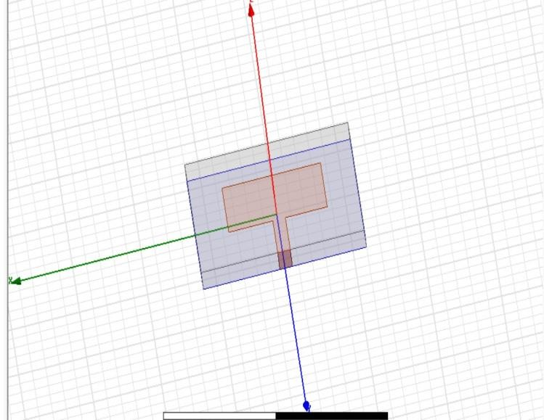

Slide 27
Task-5
Creating a design of MIMO microstrip patch antenna array design in HFSS for frequency(f) of 34MHz, display all the resulting parameters.

Slide 28
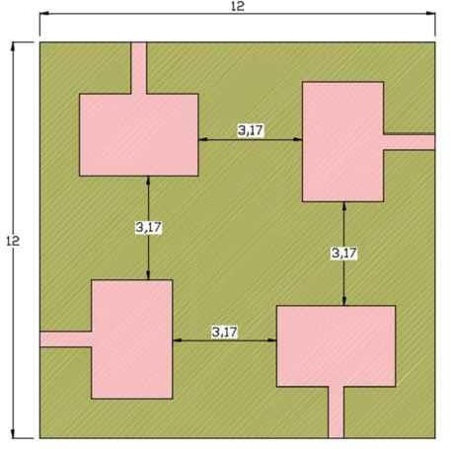
SL.no | Design parameters | Description | Obtained values | Optimized values
1 | Wp | Width of patch | 3.386 | 3.62
2 | Lp | Length of patch | 2.551 | 2.45
3 | Wg | Width of substrate and ground plane | 5.49 | 6
4 | Lg | Length of substrate and ground plane | 4.65 | 6
5 | Wf | Width of feed line | 0.46 | 0.46
6 | Lf | Length of feed line | 1.57 | 1.57

Slide 32
Task-6
Creating a design of Circularly polarized parasitic strips for frequency(f) for 34MHz in HFSS, display all the resulting parameter.

Slide 33
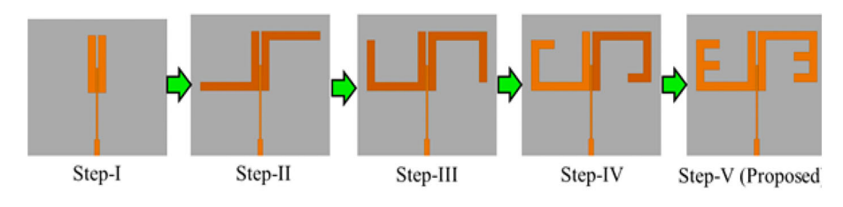
Parameters | Values | Parameters | Values
L1 | 17.8 | L9 | 6
L2 | 23 | Ls | 55
L3 | 4.5 | W | 3
L4 | 17 | W1 | 2
L5 | 9 | Ws | 50
L6 | 17.8 | Wg | 20
L7 | 6 | D | 1
L8 & Wf | 26 & 0.7 | H | 0.8

Slide 34
